Slide 1
Estimating User Stories

Slide 2
Project Planning Primer
Step 1 – Estimate your User Stories
Step 2 – Improve your estimates
Step 3 – Prioritize your user stories
Step 4 – Include Task Estimates
Step 5 – Track your progress

Slide 3
Step 1
EstimatE your
user Stories

Slide 4
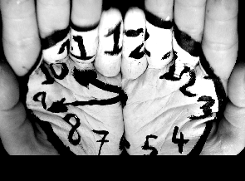
Estimate your User Stories
design
code
How long do you think will you be able to complete the story?
test
deliver
Think of only the actual work needed.
Every member of the group will produce an individual estimate.
Write down your ASSUMPTIONS.
Use the time units in the next slide for your estimates.
Important when you compare your estimates!

Slide 5

Estimate your User Stories
If your estimate falls in between of the time units, choose the larger unit
(e.g. 1½ hour will be 2 hours in your estimate).
0 hours
1 hour
2 hours
4 hours
8 hours
1 day
2 days
3 days
5 days
8
days
13
days
20
days
???

Slide 6
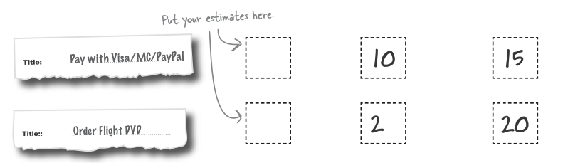
Estimate your User Stories
RECORD your individual estimates.
During your team meeting, reveal your individual estimates and COMPARE.
DISCUSS your assumptions and reasons for your estimate.

Slide 7
Estimating your User Stories
Sample discussion on the estimates…
Bob: So, why did you give the View Products Story 2 days?
Laura: I was thinking, the view is an important feature and we have to anticipate the information they will be looking for. So, there should be ways to hide and find information quickly!
You: I agree, since this is an inventory system, we have to be able to highlight important data immediately to help the user. UI Design will take some time as well, unless you guys are familiar with this task.

Slide 8
Estimate your User Stories
Time to ask: Why are the estimates different?
The larger the difference between the estimates, the LESS CONFIDENT you are in the estimate and the more assumptions you need to root out.
GOAL:
During estimation, you should eliminate as many assumptions as possible by CLARIFYING those assumptions with your CLIENT!
! Any surviving assumptions become RISKS which can lead to problems in your software development.

Slide 9

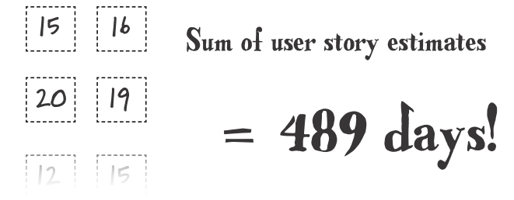
Estimate your User Stories
Once everyone’s estimates are close, AGREE on a figure for the user story’s estimate.
✼ How close is “close enough”?
When you are confident in an estimate
Comfortable with your assumptions
When you have the sum of your user story estimates, you are ready for the next step.

Slide 10
Step 2
ImprovE your estimates

Slide 11
How can we improve our confidence in our estimate?
A good estimate is one that is REALISTIC. You’ll learn the following concepts and techniques to make your estimates more realistic.
Real World Calendar
TRUTH behind Productivity
Factoring in Velocity

Slide 12
Improve your Estimates
Before we proceed, you have to do the ff:
Identify how much time you have per week to work on your INTROSE project.
Show your weekly schedule to explain how you arrived at your estimate.
Per day, identify the ff (just an example):
Class Hours | Eating | Church/Family Affairs
Sleep | Extra-Curricular | Party
Travel | Leisure (Play/Bum Moments) | Homework/ Study Time
So, how much time do you really have for your INTROSE project?

Slide 13
Improve your Estimates
When is your first iteration due?
9th Week
That’s how many days left?
Mhm, Chelsea’s probably sleeping in Math class to come up with this…

Slide 14
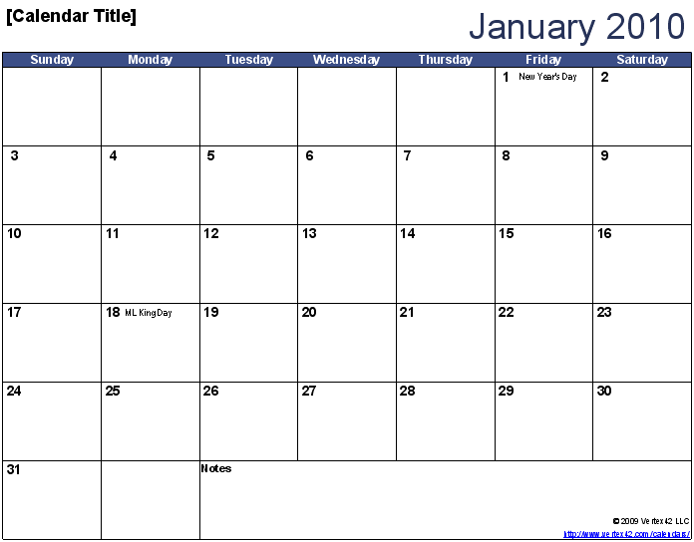
Improve your Estimates
REAL World Calendar
30 Days

Slide 15
Improve your Estimates
REAL World Calendar
X
X
X
X
X
20 Days
X
X
X
X
X
X

Slide 16
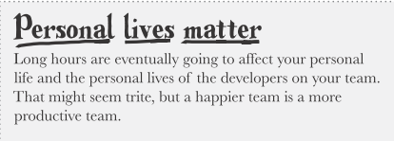
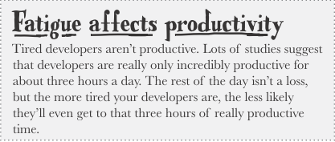
Improve your Estimates
It’s so easy to commit your team to lots of sleep overs, long hours stay in school … and LONGER work hours.
This is the reason you factor out weekends and holidays!

Slide 17

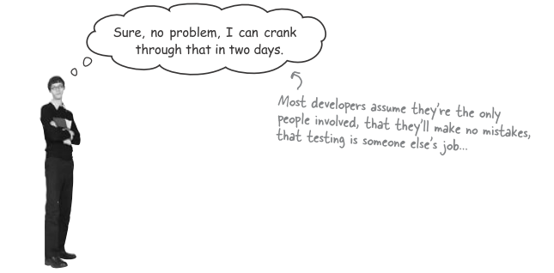
Improve your Estimates
Programmers like to think in UTOPIAN days…

Slide 18
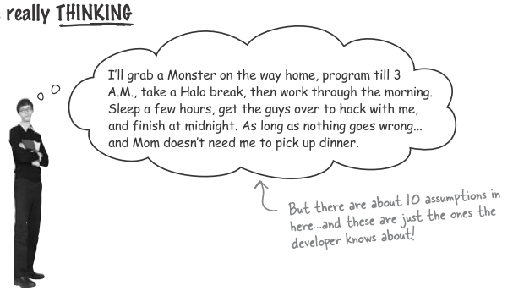
Improve your Estimates

Slide 19

Improve your Estimates
Meet your soon to be best friend…
VELOCITY
20 days x 0.7 = 14 days!
Account for time that isn’t focused on actual development!
Why is it 0.7? Roughly means your working time is 70% of your available time. As you do more estimates, you will realize what an appropriate value should be for your work habits. If your velocity is below 0.5 , you have to look at your WORK ETHICS.

Slide 20
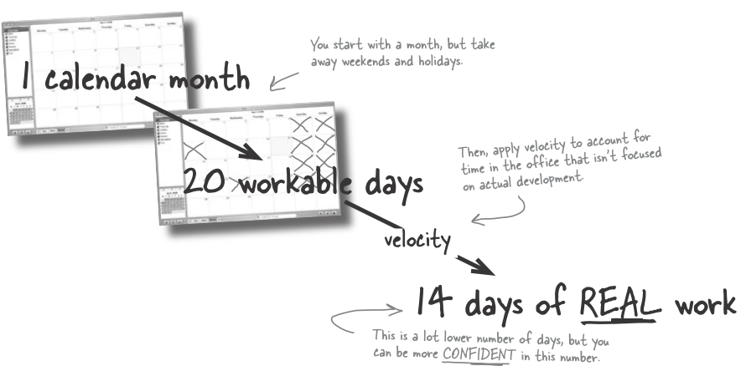
Improve your Estimates
PROFESSIONAL Developers deal with REALITY.

Slide 21

Improve your Estimates
How to apply VELOCITY?
Apply it to your amount of work (estimates on user story).
Days of Work Days Required to
Velocity Get Work Done
=

Slide 22
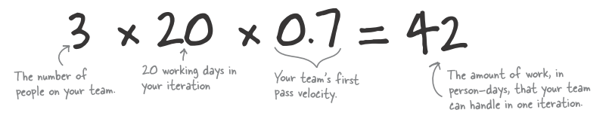
Improve your Estimates
How to apply VELOCITY?
Apply it to find out how many days of work you and your team can produce in each iteration.

Slide 23
Improve your Estimates
So how much time do you really have to do the work?

Slide 24
Step 3
Prioritize your
user stories

Slide 25
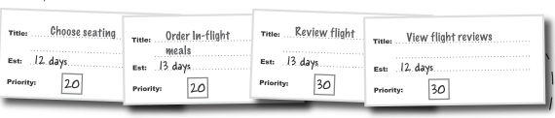
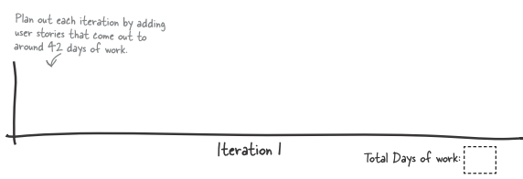
PRIORITIZE your User Stories
When your iterations contain too much work for your team, there’s nothing else to do but reshuffle work until your iterations are manageable!.

Slide 26
PRIORITIZE your User Stories
So, what happens if the features don’t fit? REPRIORITIZE.
Cut out more functionality. (those that are not absolutely critical)
Ship on delivering a milestone build as early as possible. (Choose a deadline that is not too far off)
Focus on the BASELINE functionality.

Slide 27
Prioritization with MoSCoW
Watch this video:
http://www.youtube.com/watch?v=QfZo9cxnQgY

Slide 28
MoSCoW Principle
MUST – Must be implemented. Non-negotiable.
SHOULD – Should be included if possible.
COULD – Less critical; nice to have.
WON’T – Least business value. Can have it in the future.
MUST
SHOULD
COULD
WON’T
MUST
SHOULD
COULD
WON’T
Ideal
Reality

Slide 29
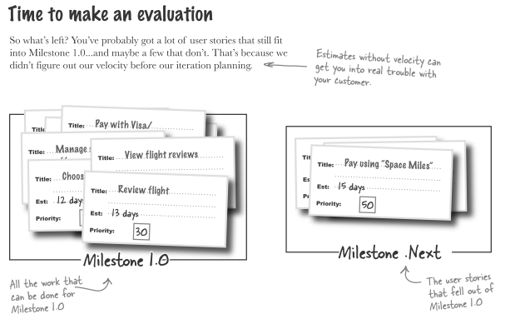
PRIORITIZE your User Stories

Slide 30
PRIORITIZE your User Stories
How to deal with PISSED OFF unsympathetic clients?
Add an iteration to Milestone 1.0
(longer schedule but at least the features will be included in the first deliverable version)
Assure that the overflow work is not lost but merely postponed.
Be HONEST about how you came up with your figures.
Explain where you are coming from!
You should promise and DELIVER rather than OVER promise and FAIL.

Slide 31
Step 4
Include
Task Estimates

Slide 32
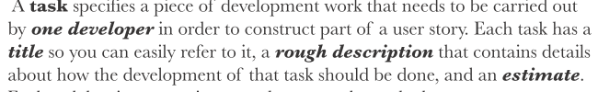
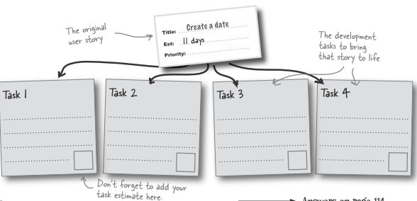
Task Estimates
Before you go assigning work to your developers, it’s better to come up with TASK estimates.

Slide 33
Task Estimates
So, what happens if my task estimates and user story estimates don’t add up?
No problem. You’d want to use the estimate that you are more confident in – in this case, the task estimates! In fact, you could have done the task estimates at the start if you have the time!

Slide 34
Step 5
Track your progress

Slide 35
Daily Meetings
Tracking your progress involves meeting DAILY (or at most within 2 to 3 days) with your team!
What do you have to track?
The user stories and tasks to be performed
State of the tasks: in progress and completed
Burn down Chart

Slide 36
Doing your meetings
“Stand Up” Meeting
So quick, you don’t have time to sit down
Agenda:
Track your progress
Update your burn-down rate
Update tasks
What happened yesterday and what’s going to happen today
Bring up any issues

Slide 37
User Stories
In Progress
Complete
Burn Down
Completed

Slide 38
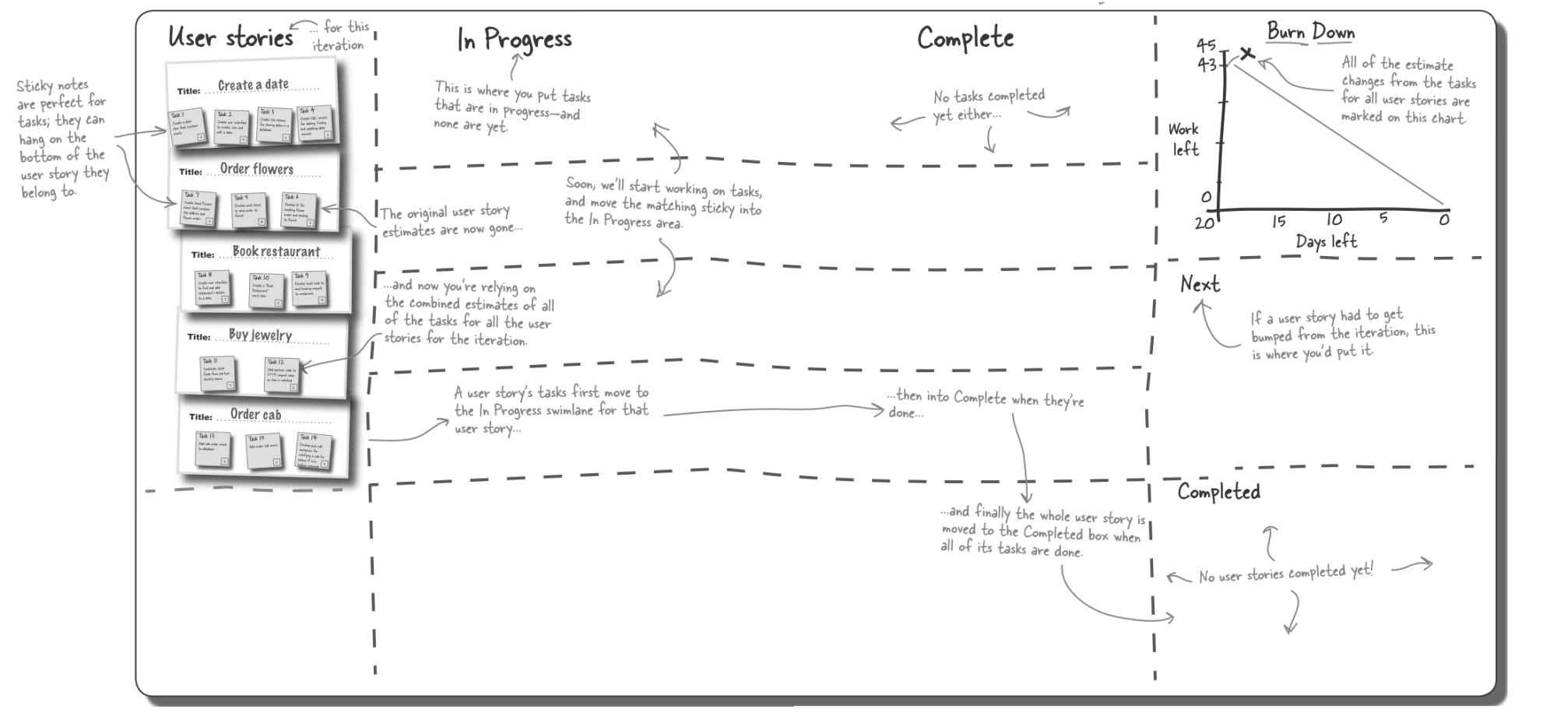
Can look something like this

Slide 39
Burn Down Charts
37
Work Left
Ideal Burn Down Rate
Can be in days or hours if you want – it’s based on the total amount of work estimated per iteration
0
20
17
14
11
8
5
2
0
Days Left
Iteration should be no longer than 20 days
(1 month of work days)

Slide 40
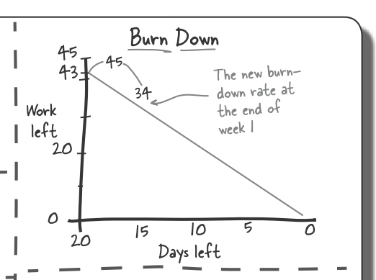
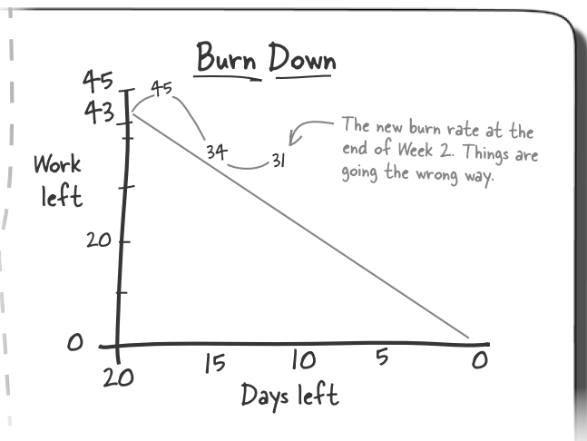
Burn Down Rate
Keep your chart updated to highlight risks!
Supports decision-making

